Slide 1

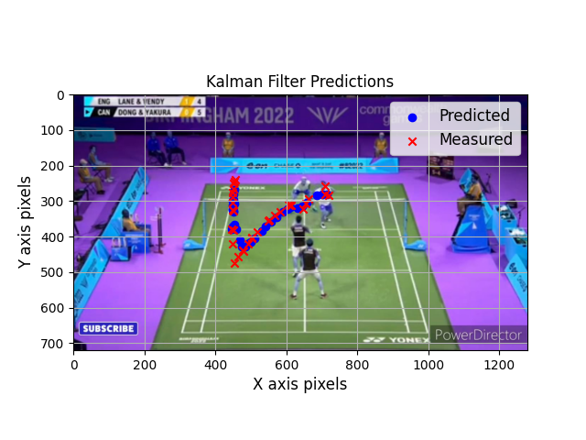
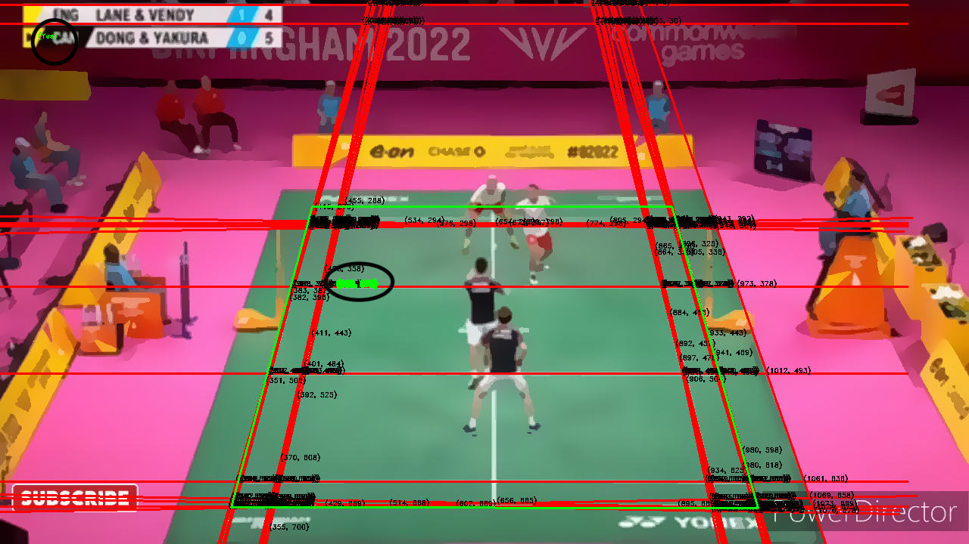
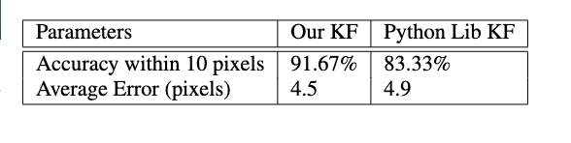
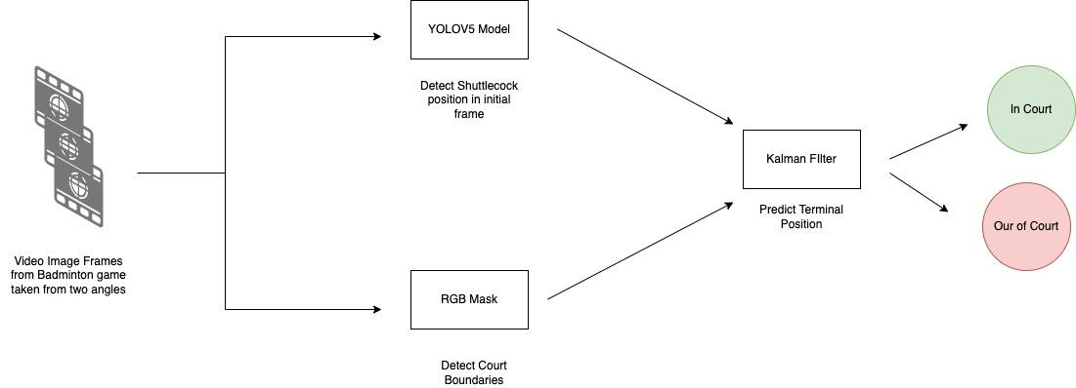
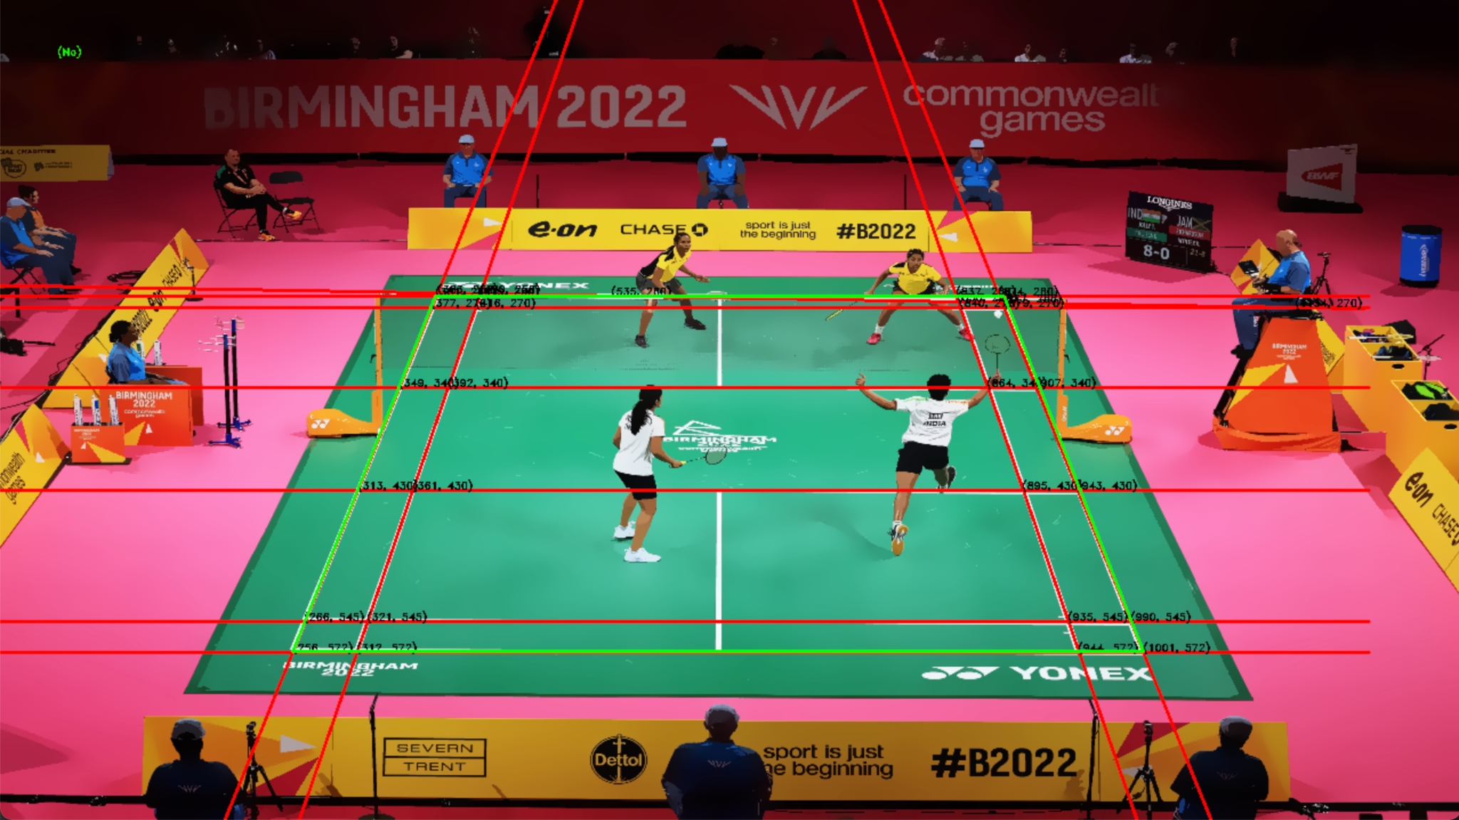
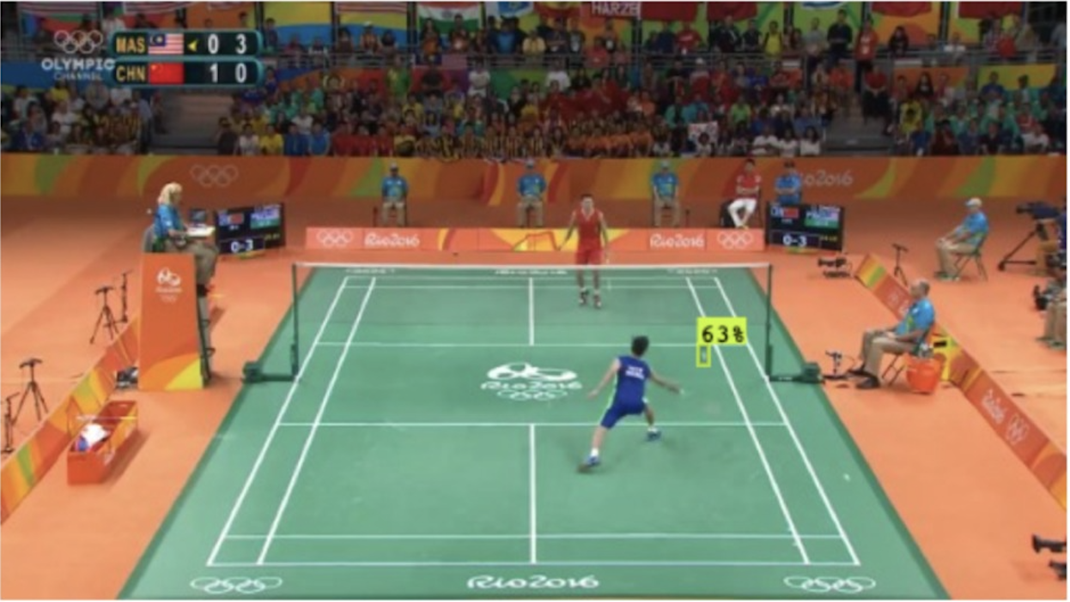
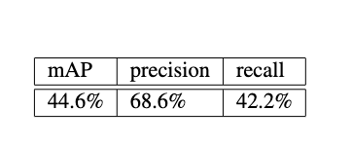
Trajectory detection and boundary estimation for badminton shuttlecock using 3D position estimation
Peter Nsaka | Bryan Mbanefo | Yaron Sternberg
Abstract
Method
Badminton is a popular sport around the world and similar to other sports, a line judgment call can often decide games. In this project, we focused on tracking a shuttlecock throughout the duration of a badminton game with the goal of determining if the shuttlecock is inside or outside of the court boundary. The unique flight characteristics and size of a shuttlecock also poses additional challenges. Factors like lighting, air conditioning, and moving mats can also significantly impact the decision of whether the shuttlecock lands in or out. In this poster, we discuss the approach taken to solve this task as well as provide a detailed analysis of the system's performance and compare it to the factual decisions.
To identify if a shuttlecock is within or outside the boundaries of the court, we build a system based on five broad subtasks:
Task 1 - Badminton video data gathering for model training and testing [2]
Task 2 - Model training using YoloV5 for initial shuttlecock detection
Task 3 - Court boundary detection
Task 4 - ,Shuttlecock trajectory and terminal position estimation using Kalman filter
Task 5 - Evaluating if the terminal position of shuttlecock is within or outside the court boundaries
Shuttlecock Tracking using Kalman filter
Shuttlecock + Line Call
Conclusions
Background
Using the methods outlined above we can successfully identify shuttlecock trajectories with stereo footage, determine court boundaries and detect if the shuttlecock is within or outside the court.
The quality and not the quantity of data is very important in substantially improving the performance of the detection system.
Several research studies have focused on developing algorithms and methodologies to track shuttlecocks in videos. Methods for tracking shuttlecocks include Fast-Tracking based on the Object Center method, the Camshift method combined with Kalman filter [1], and the use of deep learning models.
Detecting shuttlecocks is still a significant challenge compared to detecting larger objects.
Results
References
[1] idehiko et al. Shishido. A trajectory estimation method for badminton shuttlecock utilizing motion blur., 2013. Image and Video Technology. Springer Berlin Heidelberg [2] M. Cartron. Shuttlecock dataset and pre-trained model.
https://universe.roboflow.com/mathieu-cartron/shuttlecock-
cqzy3/browse?queryText=split
Court Boundary Detection
Shuttlecock Initial Detection using YOLO v5
The green lines in the figure above, are the detected boundaries of the court. From the image, we can see that we are currently detecting approximately 4 correct corners with some error

Slide 2
Abstract
Badminton is a popular sport around the world and similar to other sports, a line judgment call can often decide games. In this project, we focused on tracking a shuttlecock throughout the duration of a badminton game with the goal of determining if the shuttlecock is inside or outside of the court boundary. The unique flight characteristics and size of a shuttlecock also poses additional challenges. Factors like lighting, air conditioning, and moving mats can also significantly impact the decision of whether the shuttlecock lands in or out. In this poster, we discuss the approach taken to solve this task as well as provide a detailed analysis of the system's performance and compare it to the factual decisions.

Slide 3
Background
Several research studies have focused on developing algorithms and methodologies to track shuttlecocks in videos. Methods for tracking shuttlecocks include:
Fast-Tracking based on the Object Center method.
The Camshift method combined with Kalman filter.
The use of deep learning models.
Detecting shuttlecocks is still a significant challenge compared to detecting larger objects.

Slide 4
Method
To identify if a shuttlecock is within or outside the boundaries of the court, we build a system based on five broad subtasks:
Task 1 - Badminton video data gathering for model training and testing,
Task 2 - Model training using YOLO v5 for initial shuttlecock detection
Task 3 - Court boundary detection
Task 4 - Shuttlecock trajectory and terminal position estimation using Kalman filter
Task 5 - Evaluating if the terminal position of shuttlecock is within or outside the court boundaries

Slide 5
Results
The green lines in the figure on the left, are the detected boundaries of the court. From the image, we can see that we are currently detecting approximately 4 correct corners with some error
Court Boundary Detection

Slide 6
Results
Shuttlecock Initial Detection using YOLO v5

Slide 7
Results
Shuttlecock Tracking using Kalman filter

Slide 8
Results
Shuttlecock + Line Call

Slide 9
Conclusions
Using the methods outlined above we can successfully identify shuttlecock trajectories with stereo footage, determine court boundaries and detect if the shuttlecock is within or outside the court.
The quality and not the quantity of data is very important in substantially improving the performance of the detection system.

Slide 10
Conclusions
[1] idehiko et al. Shishido. A trajectory estimation method for badminton shuttlecock utilizing motion blur., 2013. Image and Video Technology. Springer Berlin Heidelberg
[2] M. Cartron. Shuttlecock dataset and pre-trained model. https://universe.roboflow.com/mathieu-cartron/shuttlecock-
cqzy3/browse?queryText=split

